Slide 1
Bonjour-Santé Clone
An app for booking medical appointments, viewing appointment history and viewing associated documents.
by
Dang Huynh Minh (#1670214)
Anastassia Tarassova (#1277712)
Trang M. Trieu (#6341464)
Notes:
URLS:
GitHub: https://github.com/trangtrieu-jac/BonjourSanteClone/
Trello:
https://trello.com/invite/b/67b7fc2990532c3fd8178605/ATTIf6c4deff3246dd22ea20a22b0837b5734D3AE554/fsd13-team2

Slide 2

Background of project
Most people have used the real
Ana used Bonjour-Santé as a patient and as a healthcare professional
Project will look great in a Portfolio
Fun challenge

Slide 3
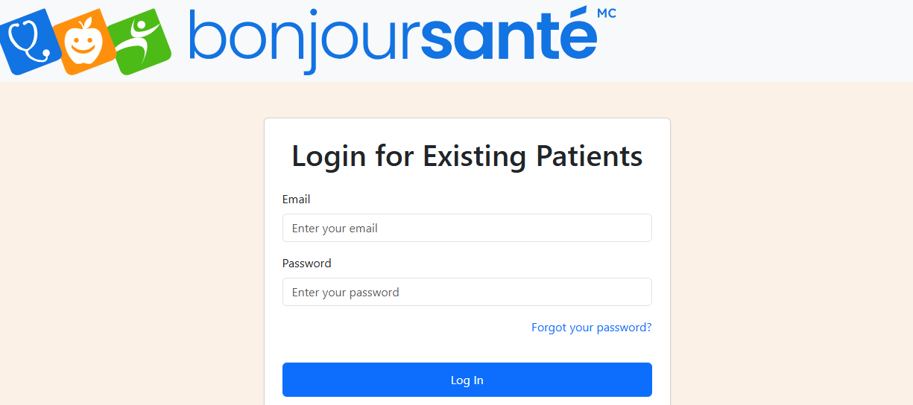
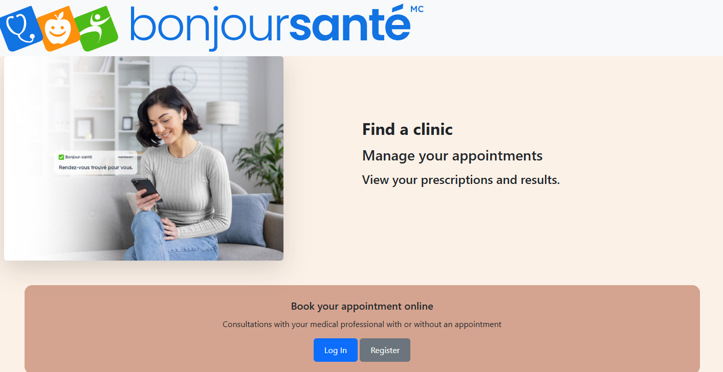
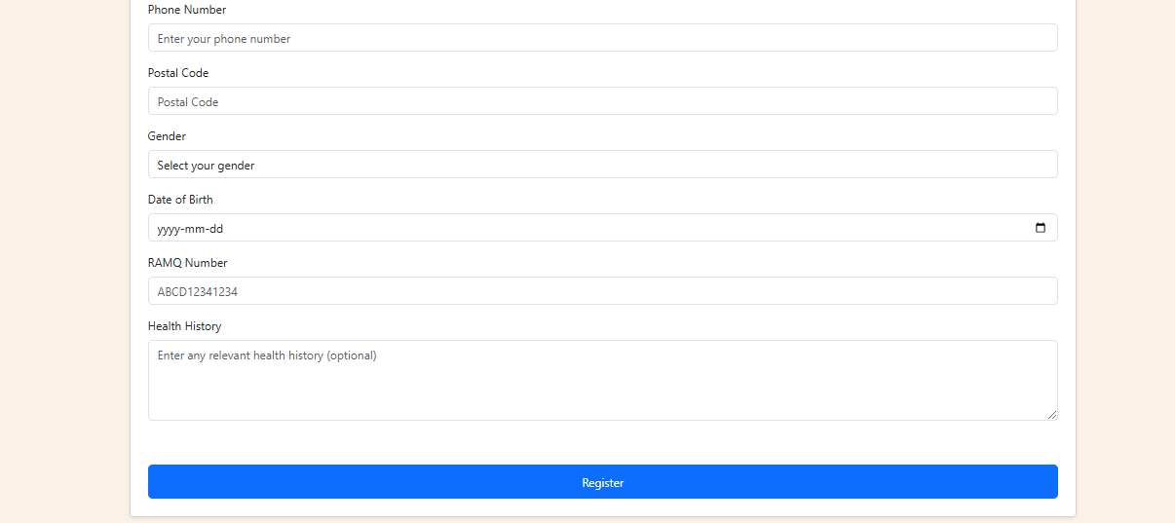
Solution overview
Users can log in
Users can register

Slide 4
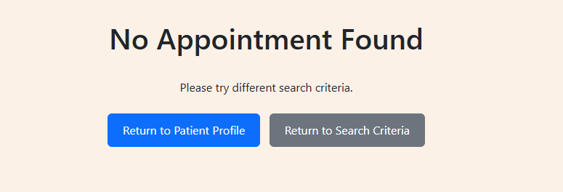
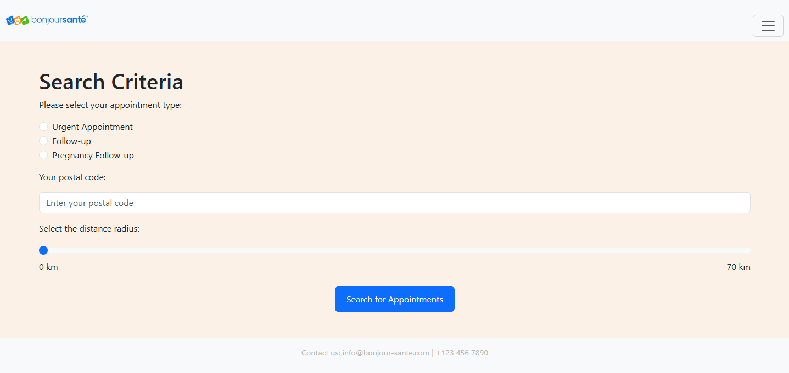
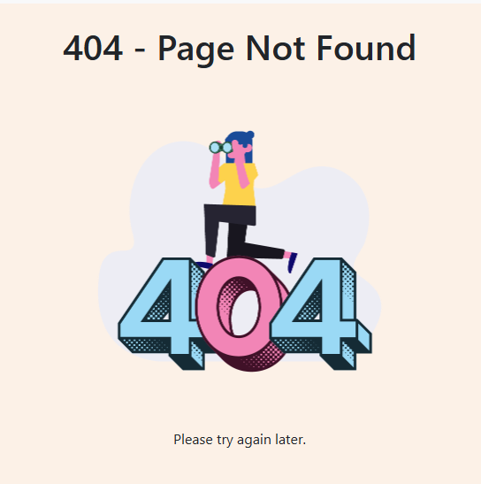
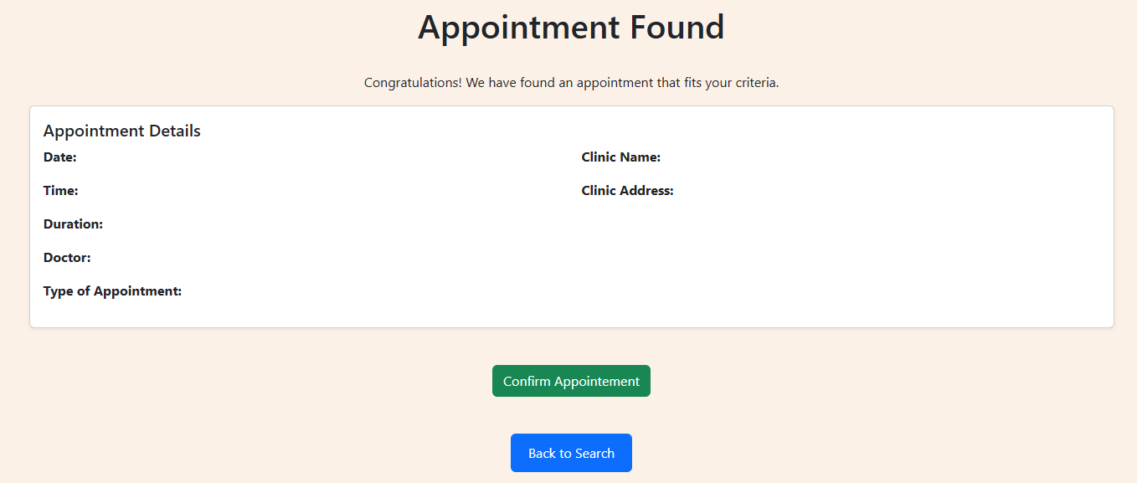
Solution overview
Patients can book appointments

Slide 5
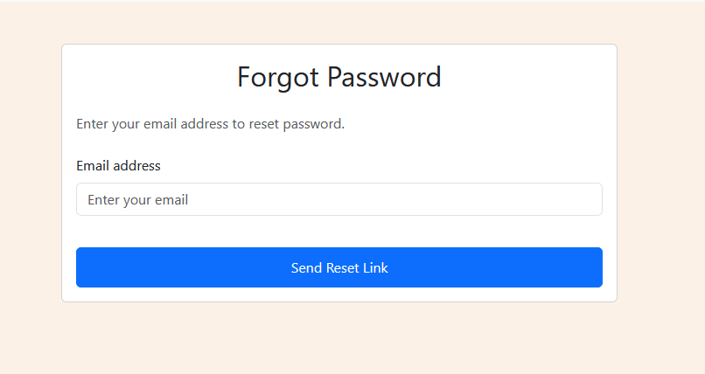
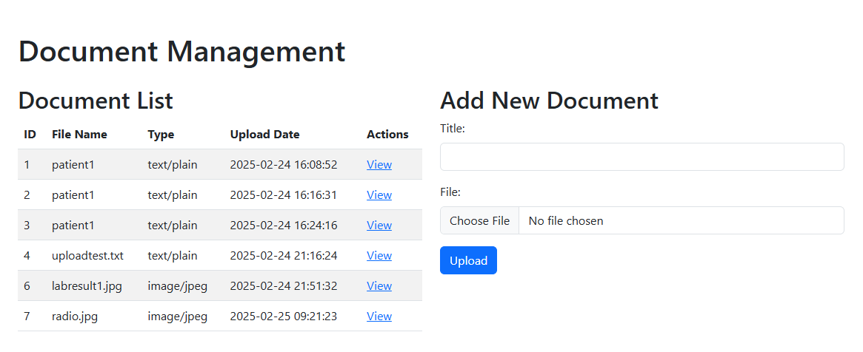
Solution overview
Users can view and upload documents
User can get password reset
Notes:
- show your solution from high level, e.g.
screenshot(s), list main features from
user point of view, features, functionalities.
Say WHAT was implemented BUT NO DETAILS ON HOW.

Slide 6
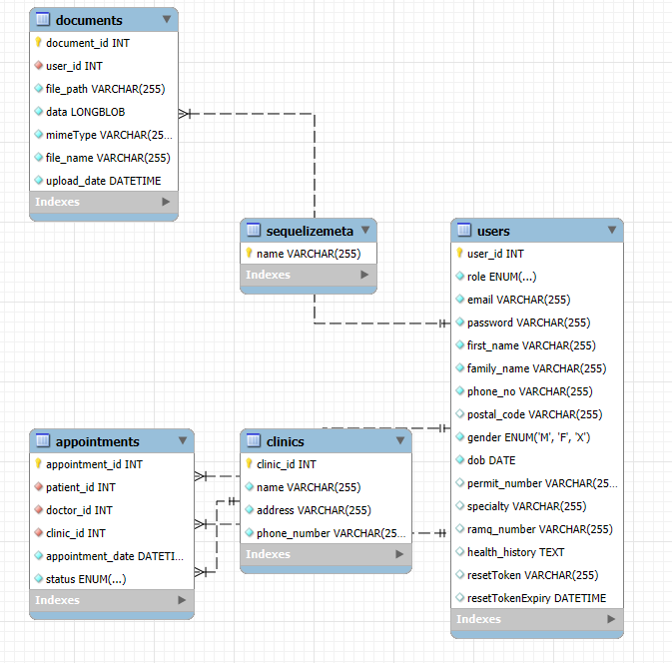
Database structure

Slide 7
Roles
Dang: appointment and clinic management.
Ana: front-end, user login and registration.
Trang: password recovery and documents (BLOB).
Everyone: testing.
Notes:
add a slide of who did what. It’s okay to list things twice if it was teamwork.

Slide 8
Challenges (Dang)
Technologies used: (sessionStorage), mySQL, Sequelize, Postman
- retrieving information for the database to the current session using patient_id
- time discrepancy between MySQL/Postman and Sequelize (?) in VSCode
Future solutions
- try using user_id or email for the functions in the controller, patient_id adds difficulties
Try to implement moment.js directly

Slide 9


Challenges and Solutions

Slide 10
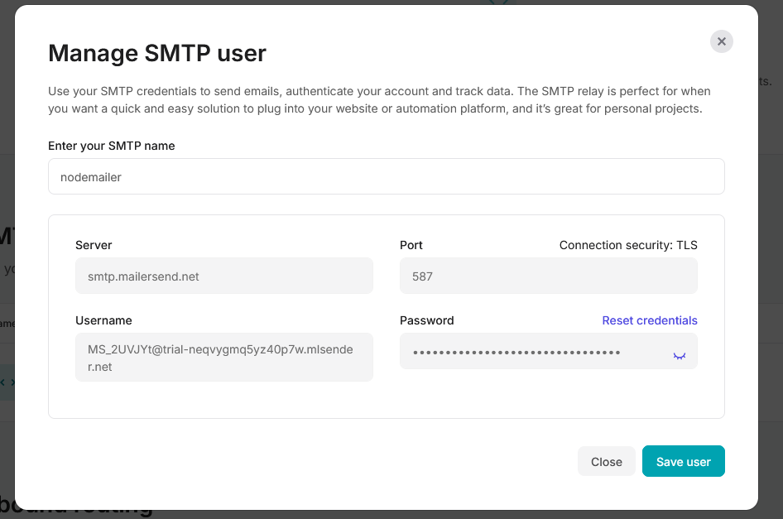
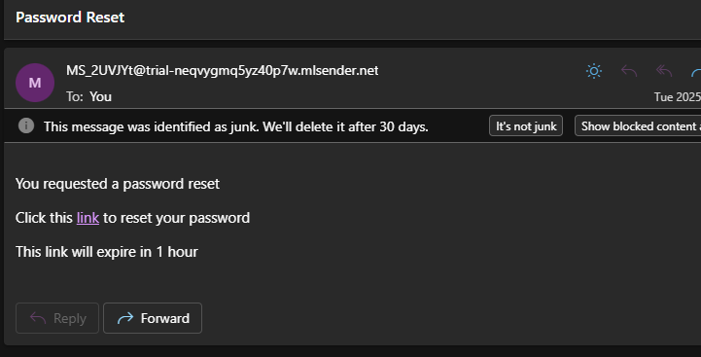
What we learned (Trang)
Password recovery: nodemailer and mailersend.com

Slide 11
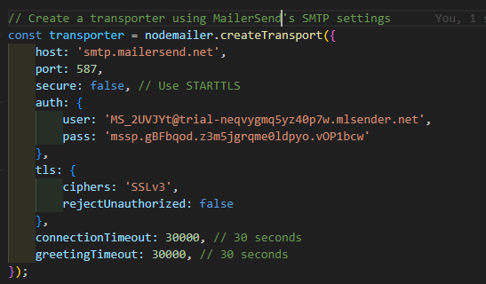
What we learned (Trang)
Source: SMTP transport :: Nodemailer

Slide 12
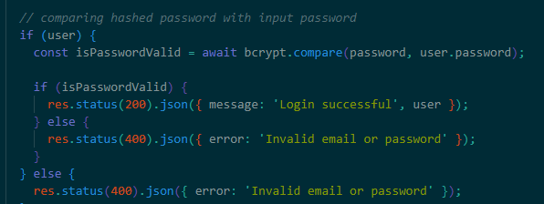
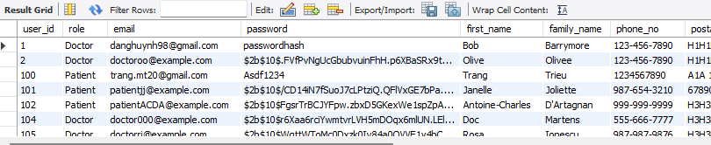
What we learned (Ana)
Interesting technologies used:
Challenge: Encrypting the password without using https:// (SSL/TSL certif)
Solution: npm install bcrypt
Upside: Easy to use
Downside: Need to do password recovery if password forgotten
Notes:
Teach Greg how to solve a problem
* 4-7 slides: What we learned - teach it! Teach one or two things.
- talk about specific, low-level solutions
and teach them to the students and teacher
= Teach me how to solve ONE (or two) problem.

Slide 13
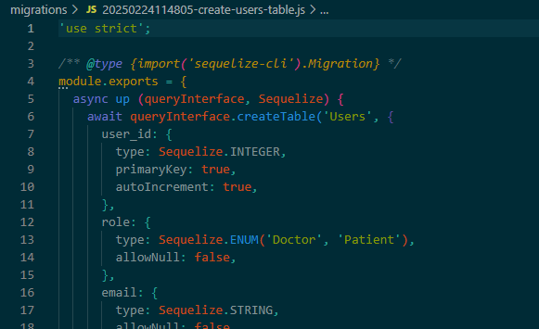
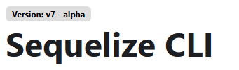
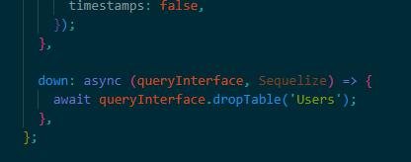
What we learned (Ana)
Interesting technologies used:
Challenge: Updating a table with Sequelize instead of MySQL
Solution: Migrate a table.
Upside: Ensures coherent data structure across full project.
Downside: None.
Notes:
Teach Greg how to solve a problem
* 4-7 slides: What we learned - teach it! Teach one or two things.
- talk about specific, low-level solutions
and teach them to the students and teacher
= Teach me how to solve ONE (or two) problem.

Slide 14

Future work (1 slide)
Extra features from the proposal:
Distance calculation between patient and clinics
What could be done with one extra week:
Storing all images on cloud (instead of MySQL and HTML)
Improving doctor's GUI and adding more roles (sysadmin, nurse, statistician, etc.)
Improved medical history (allergies, medication, summary of past visits)
- Linking with patient pharmacy, sending Rx by email/fax

Slide 15
Summary (1 page)
We built a Bonjour Sante clone website with booking system.
Users can register, login and view their profile.
Users can view and update documents.
A list of past/future appointments can be seen.
Appointments can be booked and deleted.
Some features are missing/not completed.
Each feature functions while being loosely connected to each other.

Slide 16
Thank you for listening
Enjoy spring break!

